Slide 1

Spring 2026 Senior Design Project
Indoor/Outdoor Localization and Mapping
April 14th, 2026

Slide 2




Our Team
Demetrius Hullum Scott
Ryan Hardek
Joey Sanuk
Noah Emmert
Graduate Mentor: Nadim Mahmud
Advisor: Dr. Vaskar Raychoudhury

Slide 3
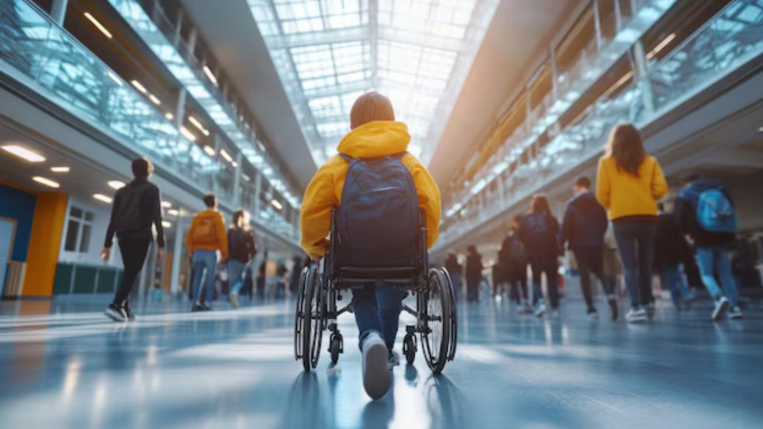
Current Problem
People with blindness and/or low vision (BLV) face daily challenges navigating unfamiliar & complex environments.
Existing camera-based solutions are less robust in indoor environments, and introduce privacy concerns.
Alternative solutions, such as LiDAR, are too expensive.

Slide 4
Project Description
Calibration
This project develops a multimodal navigation system for wheelchair users that fuses IWR1843 mmWave radar and camera data through machine learning to provide real-time, auditory guidance for obstacle avoidance and environmental awareness.
Data Collection
Model Development
LLM Integration

Slide 5
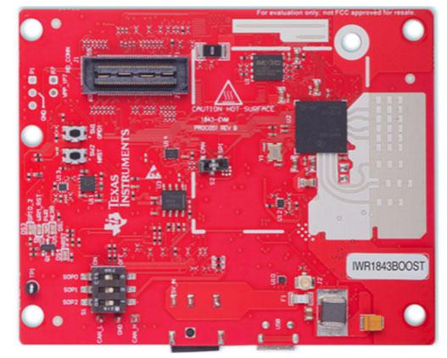
What are mmwave radars?
Radars that operate at very high frequencies
Use a technology called FMCW (Frequency Modulated Continuous Wave)
The radar can determine an object's range, velocity, and angle with high accuracy
More cost effective than LiDAR
Bin data format that is parsed into csv
IWR1843BOOST - The mmwave radar used for this project

Slide 6
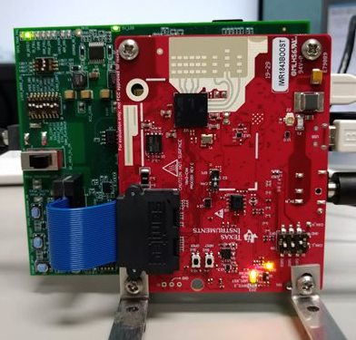
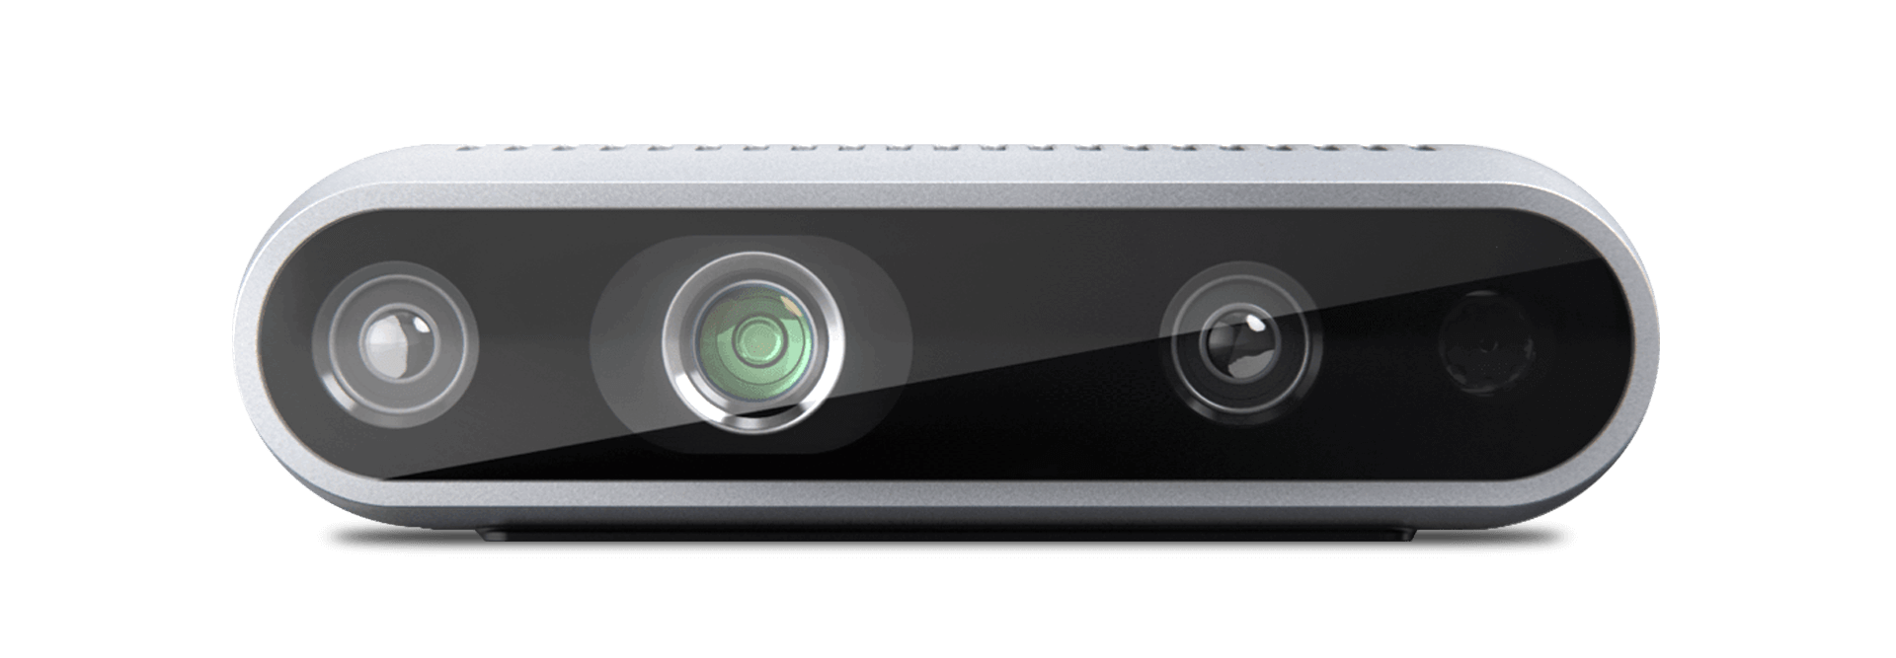
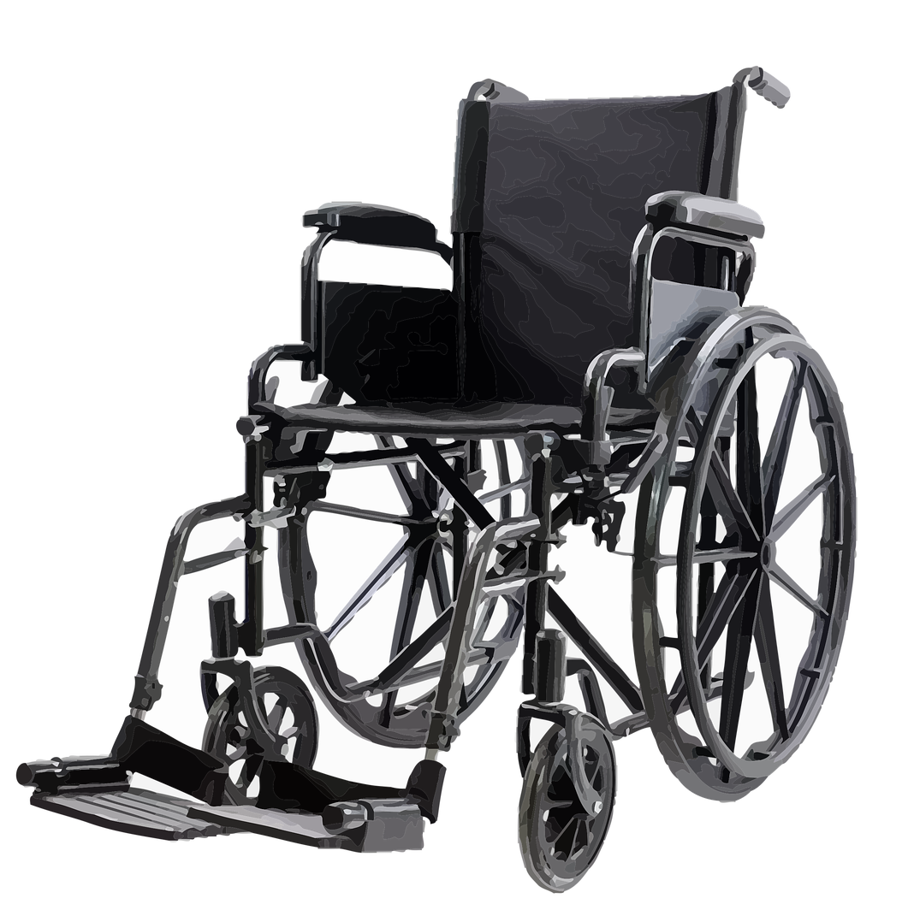
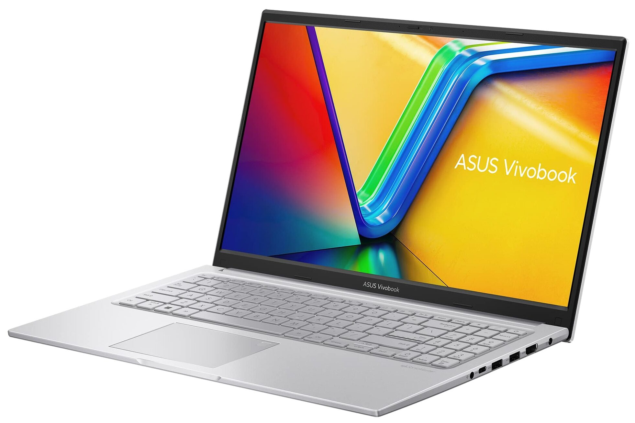
Initial Hardware Setup
The mmwave radar and camera were both attached to our wheelchair. As they collected data, it was fed into our computer.

Slide 7
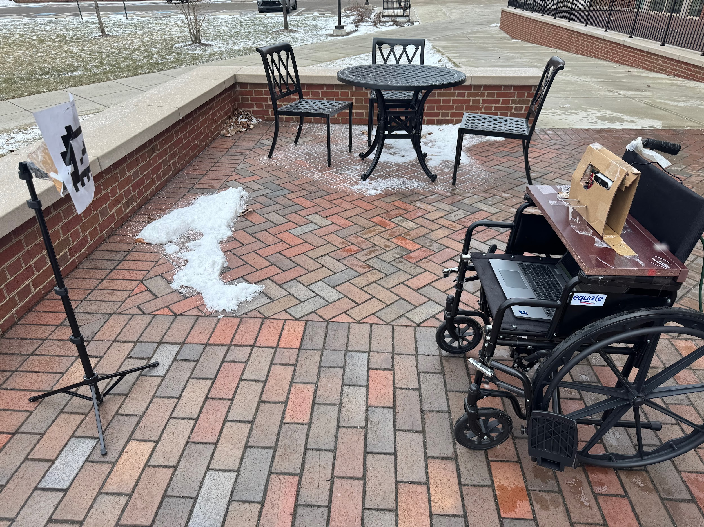
Initial Hardware Setup

Slide 8
Why Calibration is Required
Radar and camera systems see the world very differently, a radar point x,y,z does not translate to the same x,y,z, in camera space
After we related the two different coordinate frames, we then had access to projection which would later be used for labeling points

Slide 9
Calibration Data Collection
Conducted calibration in the McVey Data Science Building
We used an AprilTag mounted to a metal corner reflector to produce strong point clouds
We then shifted the position of the reflector to gather different angles and samples to create a projection matrix

Slide 10
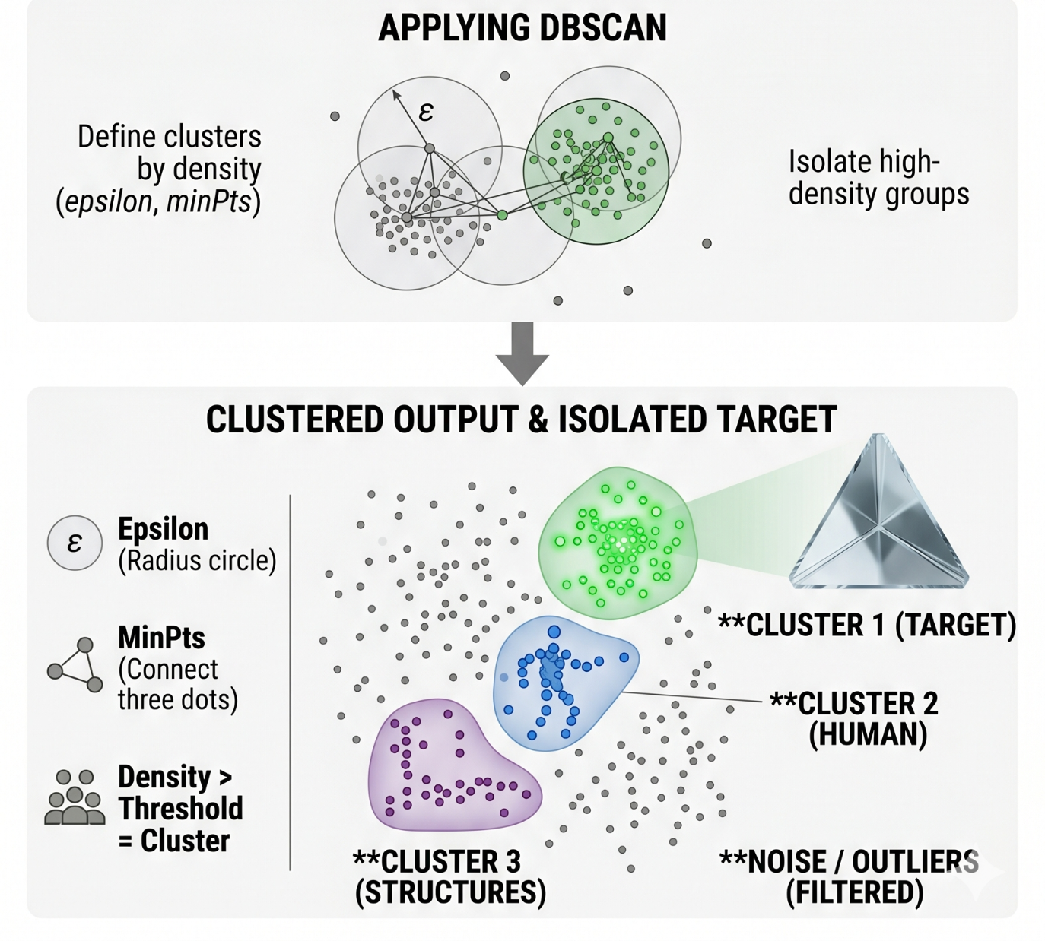
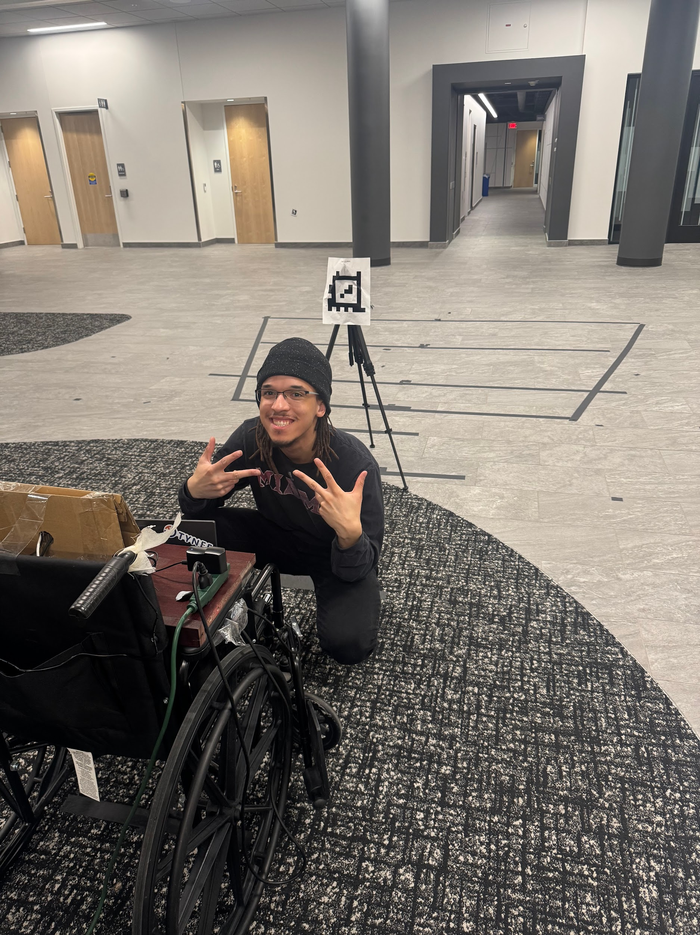
Calibration Pipeline
DBScan Clustering
Remove sessions with background movement
Use camera RGB/depth to align AprilTag to radar cluster
Optimize rotation and translation matrices

Slide 11

Static Calibration Video

Slide 12
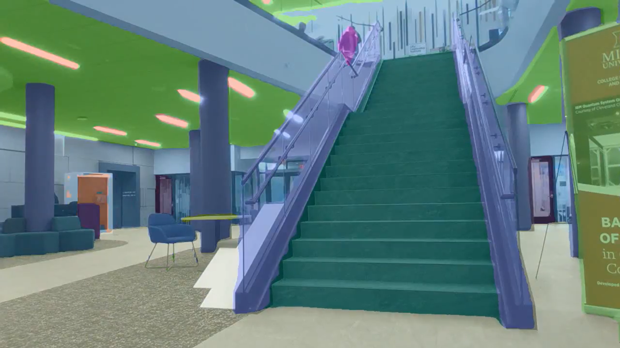
Label Mapping
OneFormer Segmentation
Applies a mask that assigns each object (wall, pillar, etc) a class
If a projected radar point falls onto that mask segment, it gains that label
Labeled points were then used in model training
3 Primary Classes
Structure
Floor
Human

Slide 13
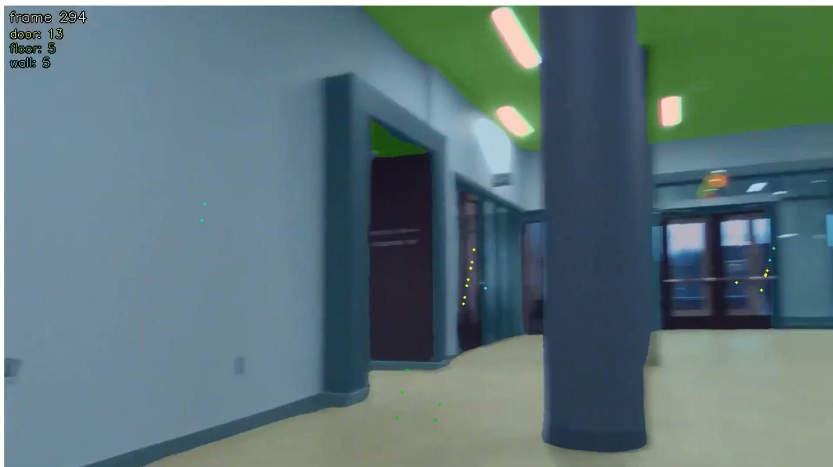
Segmentation Video

Slide 14
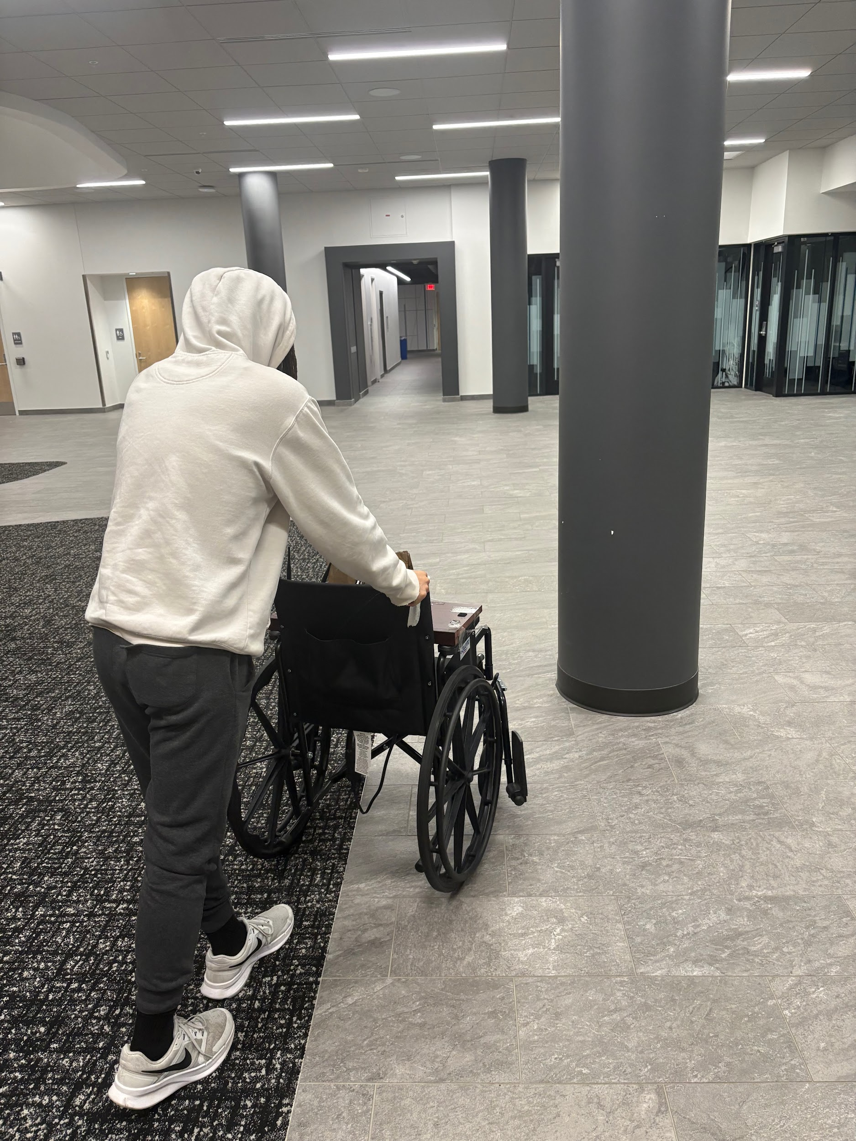
Model Data Collection Pipeline
Captured over 45+ videos in McVey of varying environments such as classrooms, hallways, lobby
Collected data on a variety of possible obstacles including humans, tables, chairs, walls, pillars, trash cans, etc.

Slide 15
Model Development
Inference Model
Temporal DGCNN + KPCONV (85%)
DGCNN
Analyzed relationships between the point cloud features (azimuth, doppler, etc.)
KPCONV
Analyzed spatial relationships between point clouds (x,y,z) through spherical geometry
Metric / Class | Accuracy Score
Balanced Accuracy | 85.34%
Structure | 90.30%
Floor | 82.49%
Human | 83.24%

Slide 16
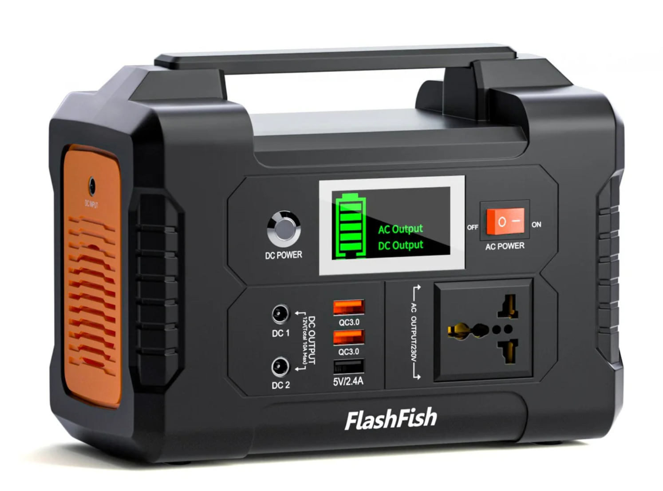
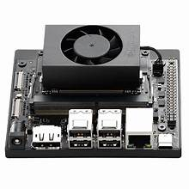
Final Hardware Setup
The addition of the Jetson Orin Nano allows us to have portable and dedicated processor that mimics the way this project could be usable in a real setting

Slide 17
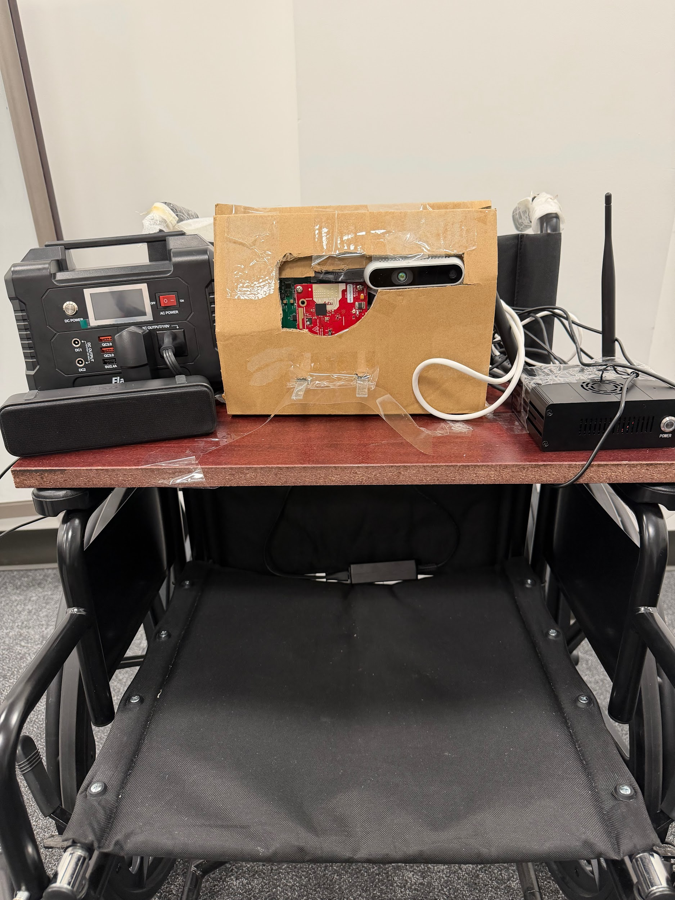
Real-Time Inference & LLM Integration
Scene aggregation creates a scene based on the model output
Object classification
Object location
Intermediate LLM guidance script that formulates which areas are clear to move in and if things are approaching
LLM-TTS to provide the user with spoken guidance on how to move forward

Slide 18

Looking Ahead
Improve model accuracy and add more classes (more features and data diversity are required)
Improve LLM navigation (both software and hardware)
Integrate outdoor navigational system and spatial database
Paper submission to International Conference on Advanced Visual and Signal-Based Systems (April 20th)
URA Expo (April 24th)

Slide 19
Thank you!

Slide 20
Questions?

